Slide 1
Say It Loud:
Using Oral Presentation to Assess General Education
Quinsigamond Outcomes Research for Excellence
AMCOA Feb. 1, 2019

Slide 2
Overview of the Entire Process
Fall 2016
Assembled team to work on Oral Presentation Assignment Framework and Toolkit
Summer 2017
Invited interested faculty to design oral presentation pilot and met several times
AY 2017-2018
Collected student work from participating faculty members
Summer 2018
Assessed student work and met to discuss results
Notes:
Fall 2016: writing toolkit participants; MSC invitees who told us they had oral presentation projects; all SPH 101 faculty. Tiger did a literature review looking for best practices and could not find anything about Gen Ed oral presentation, only oral presentation in speech or specific classes.
Summer 2017: Some of the same people; revisited faculty list who couldn’t do toolkit but expressed interest in next steps.
AY 2017-2018: Extended into SP 17 because of technical issues and time needed to videotape/collect work. Some faculty needed to make changes to their assignment as well. Changed assignments because of work we did on assignment design.
Summer 2018: Met once in May to norm and walked through process of how to access rubrics and videos. Had a month to assess on one’s own time. Each person had 11-12 videos to assess. Each video assessed by 2 people.

Slide 3
Process for the Collection of Student Work (Pre-Assessment)
Make decisions about assessment project logistics
Set up assessment project in Blackboard Outcomes Assessment
Create assignments for student work in Blackboard course
Video technology training with Media Services
Collect student work
Align student work to Hoonuit/Atomic Learning

Slide 4
Process for Assessing Student Work and Post-Assessment Work
Find student work they need to assess in Blackboard Outcomes Assessment
Return to Blackboard Outcomes Assessment to complete assessment
Annotate assignment for inclusion in the Educator Idea Vault
Find corresponding videos in Hoonuit/Atomic Learning and watch
Meet as a group to discuss results
Complete reflection response
Notes:
Reflection areas: 1. Curriculum, 2. Assignment and Topic, 3. Process, 4. Resources, 5. Stakes, 6. Student Impact

Slide 5
Assessment Time: Your Turn!
Notes:
https://drive.google.com/drive/folders/1lUR-e2o28E--aSAWlWQZv9hMgEtgdpoJ

Slide 6
11
8
64
Number of Assessors
Number of Contributing Faculty
Number of Student Oral Presentations Assessed
Notes:
Mention that each work was assessed by two people

Slide 7
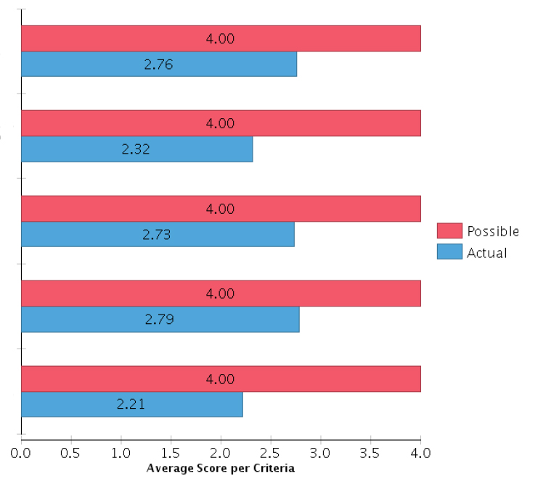
OverallResults
Message
Delivery
Context
Content/ Knowledge
Use of materials
Notes:
Define each:
Content/Knowledge Establish field-specific knowledge or perspectives (incorporates theories and practices of the relevant field, and employs appropriate field-related terminology and genre conventions).
Context Adapt to audience and relevant conditions (e.g., social/cultural/historical context in general; prevailing trends in field, etc.).
Delivery Apply effective oral presentation techniques: Appropriate posture, gesture, proxemics, eye contact, language, vocal expressiveness and chronemics, and conveys poise and confidence. Calibrate to message, context, materials and content.
Message Convey the following: Purpose, compelling interest, rhetorical appeal, authority, credibility, and internal coherence.
Use of materials Identify, categorize, evaluate and cite information resources appropriate to the topic. Use supplementary materials that enhance message and fit delivery style.

Slide 8
They are teaching, really: Sharing insights that are based on research and personal experience... whose use is to educate their audience. This requires considerable meaning-making and authentication, as well as audience awareness.
Notes:
IMPACT On a research-based assignment: “I noticed that students did better this semester since I provided them more tools such us a detailed evaluation rubric, and instructions for both the paper and the presentation. We spent a lot of time doing mini projects to give my students the opportunity to do speech practice. … [O]ral presentations help students become active and autonomous learners.”

Slide 9
Detailed Results
Criterion | % Exemplary (4) | % Proficient (3) | % Developing (2) | % Novice (1) | % Not evident (0) | Mean | Median/Mode | Standard Deviation
Message | 25 | 35 | 33 | 8 | 0 | 2.76 | 3.00 | .92
Delivery | 9 | 30 | 44 | 16 | 1 | 2.32 | 2.00 | .88
Context | 19 | 44 | 29 | 7 | 1 | 2.73 | 3.00 | .88
Content/ Knowledge | 25 | 37 | 29 | 8 | 1 | 2.79 | 3.00 | .94
Use of Materials | 15 | 26 | 34 | 14 | 10 | 2.21 | 2.00 | 1.18
Notes:
Standard deviations are high. Locating future assessments in programs and departments would likely narrow the range, both on the assignment side and the evaluator expectations side.
Use of Materials especially spread out. Norming sessions included MUCH discussion of this criterion. Future projects should clarify whether this means information resources used for the CONTENT of the presentation, or any materials, visuals, etc. used to DELIVER the presentation.
Also, standard spoken English was a point of lively discussion. Where accent or speech disfluency impeded delivery, we disagreed about the impact of these on score. For this project, with its objective of exploring oral pres efficacy for gen ed assessment, we landed on emphasizing content, message, etc. Projects located in ESOL or career programs might elect to emphasize delivery in discipline- or industry- specific ways.

Slide 10
[O]ral presentations help students become active and autonomous learners.
Notes:
IMPACT On a research-based assignment: “I noticed that students did better this semester since I provided them more tools such us a detailed evaluation rubric, and instructions for both the paper and the presentation. We spent a lot of time doing mini projects to give my students the opportunity to do speech practice. … [O]ral presentations help students become active and autonomous learners.”
Evaluator comments collected and coded analytically (more for the practice of the QORE team and to test/establish process for future assessment projects). Ranged from comments on their scores, to content of speech to visual presentation elements to quality of video of the speech.
Our greatest challenge going forward is scale. Any creative ideas from the audience?

Slide 11
Place your screenshot here
Educator Idea Vault
Toolkit Overview
How to Logon to the Educator Idea Vault
Go to http://mycourses.qcc.edu
Log into Blackboard with the User ID eiv (for "Educator Idea Vault") and the password explore
Notes:
Have Blackboard logged on in the background and go to the EIV.

Slide 12
Thank you!
Quinsigamond Outcomes Research for Excellence qore@qcc.mass.edu
Amy Beaudry, abeaudry@qcc.mass.edu
Gaelan Benway, Chair, gbenway@qcc.mass.edu
Maureen Giacobbe, mgiacobbe@qcc.mass.edu
Tiger Swan, tswan@qcc.mass.edu

